Slide 1
Visualize an Analyze Energy Data
Presented by Sherri Koski, IOT Analytics
Aug 31, 2020

Slide 2
Objective
IOT Analytics will determine based on data whether the data supports Jane Doe’s claim that she was not occupying a specific residence during an event that occurred in Aug 2008.
IOT Analytics will determine energy usage pattern in the home from January 1, 2007 to December 31, 2009.

Slide 3

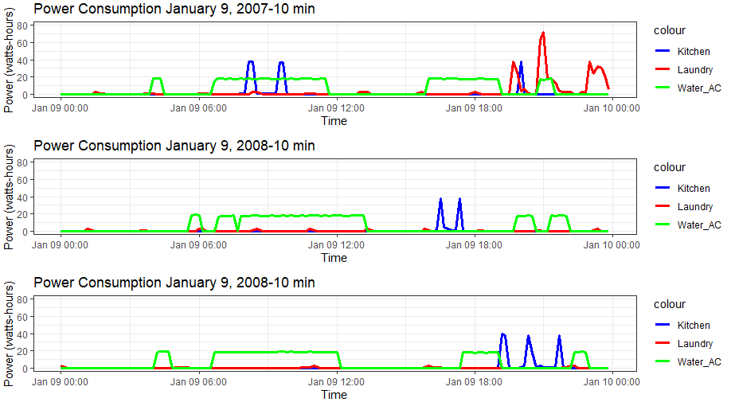
Energy consumption on Jan 9. Data from 2007, 2008, and 2009.

Slide 4
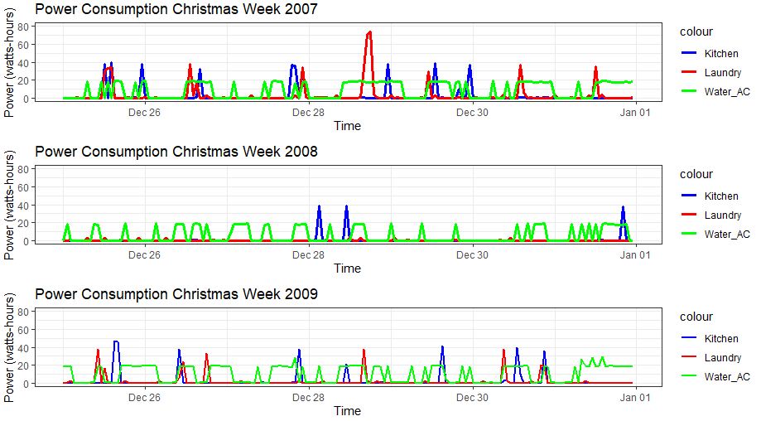
Energy consumption from Christmas Week. Dec 25-Jan1.
Data from 2007, 2008, and 2009

Slide 5
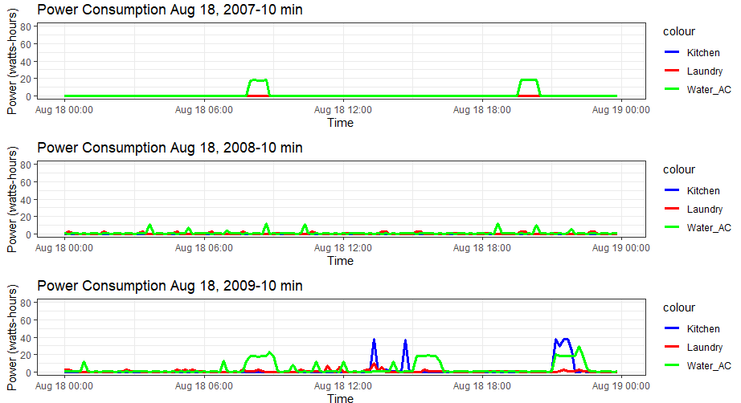
Energy consumption on Aug 18. Data from 2007, 2008, and 2009.

Slide 6
Aug 18 has lower Power Consumption than Jan 9 and Christmas Week.

Slide 7
Energy usage per area remained constant from 2007-2009.

Slide 8
Energy use on Jan 14, 2007, 2008, and 2009 at
8 am, noon, and 9 pm.
8 am was a typical time for usage as well dinner was eaten late between 8 and 9:30 pm.

Slide 9
It appears that Christmas 2008 was not celebrated at home.

Slide 10
On Christmas 2007, it appears that lunch and dinner were cooked and eaten at home.

Slide 11
The entire month of August 2008 had lower energy usage than 2007 and 2009. This is the month the client claims to have not been home.

Slide 12
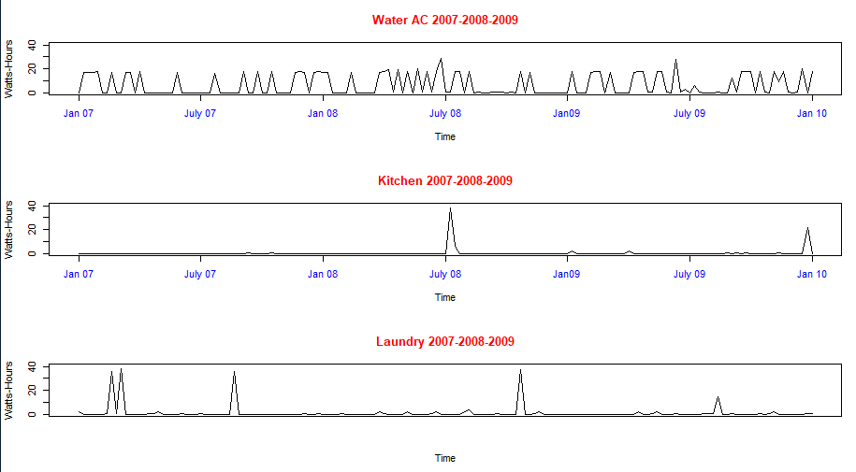
Comparing Water AC, Kitchen, and Laundry usage from 2007-2009.
Arrow points to August 2008.

Slide 13
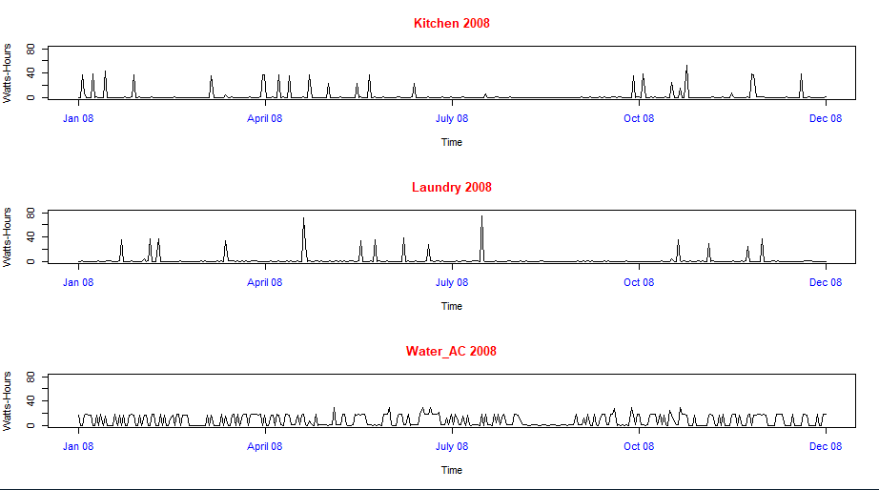
Now, same thing but only the year 2008. Notice the lull in August 2008.

Slide 14
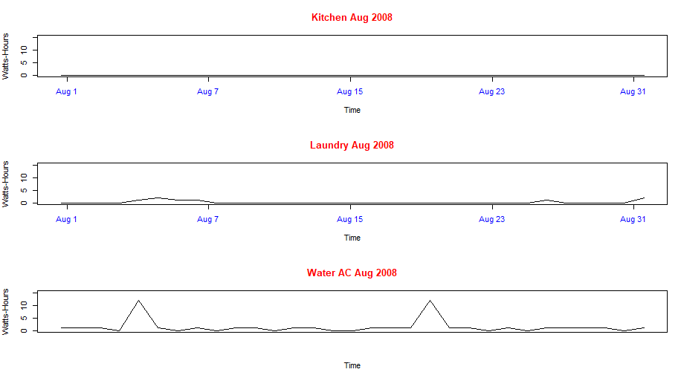
This is August 2008. The month the client states that she was not home. Generally, little or no use this month. I would guess the peaks in water were to wash clothes before leaving and after coming home.

Slide 15
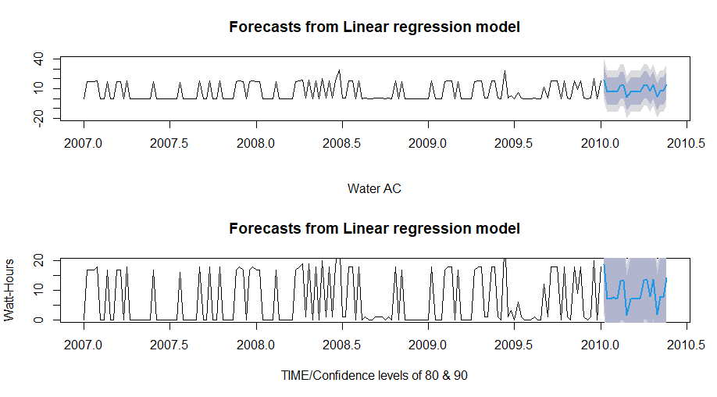
Water AC Linear Regression Forecast Visualization

Slide 16
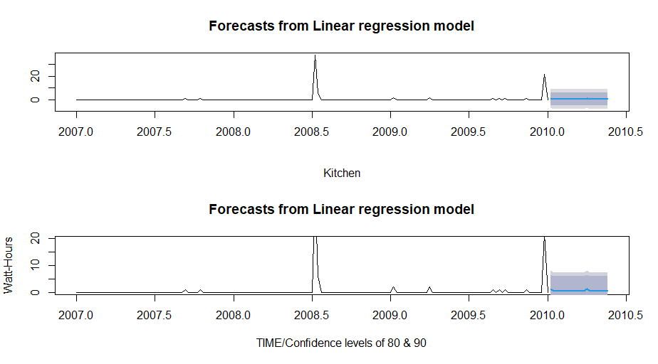
Kitchen Linear Regression Forecast Visualization

Slide 17
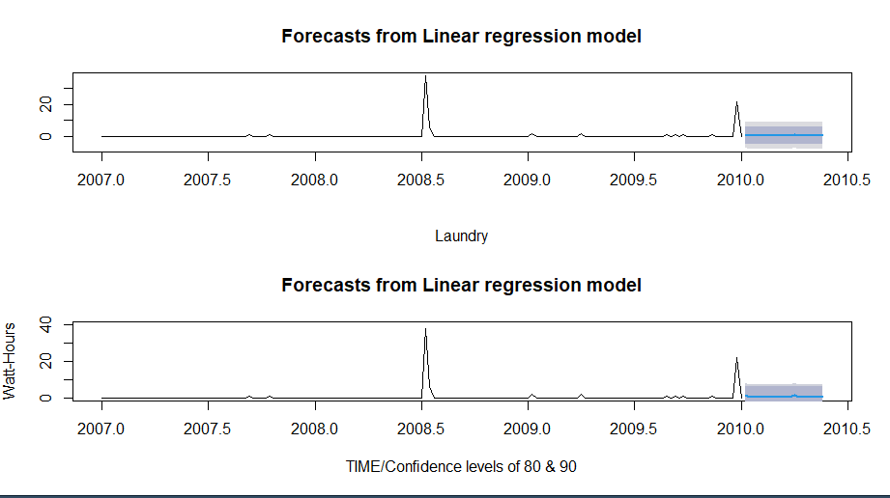
Laundry: Linear Regression Forecast Visualization

Slide 18
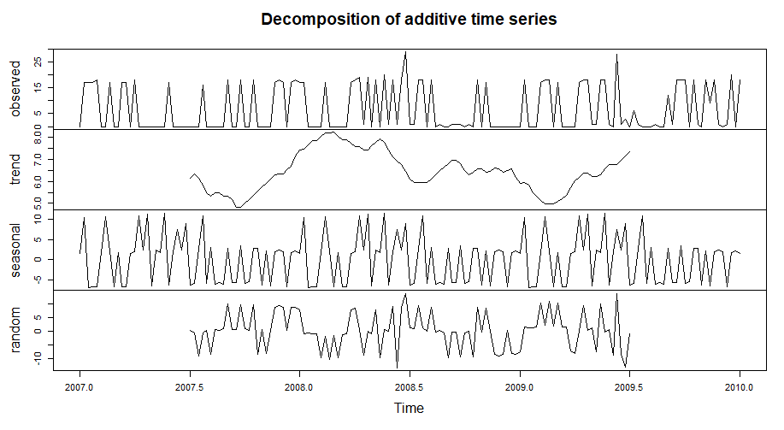
Water AC : Decomposition Visualization

Slide 19
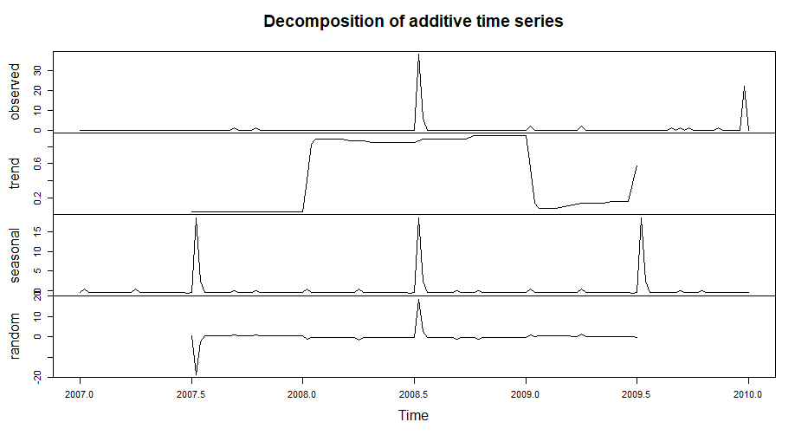
Kitchen: Decomposition Visualization

Slide 20
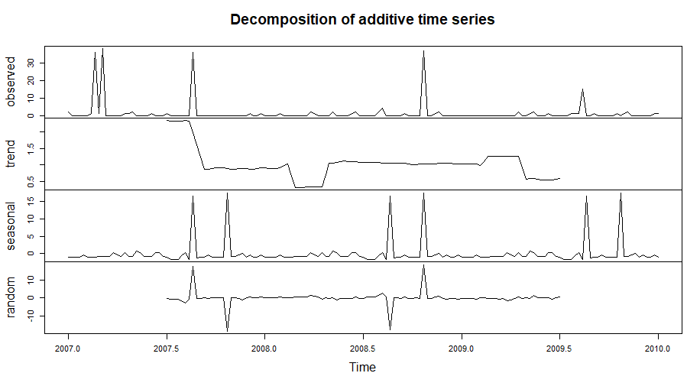
Laundry: Decomposition Visualization

Slide 21
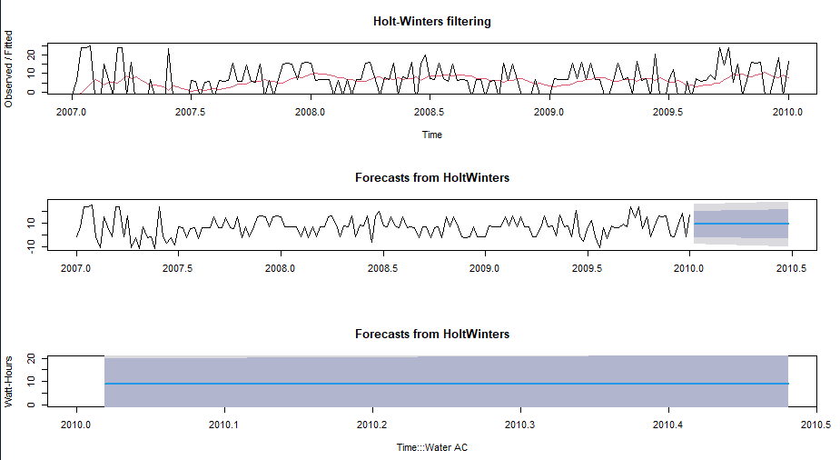
Water AC Holt-Winters Forecasting
Expect Water AC to be 10 Watts/Hour

Slide 22
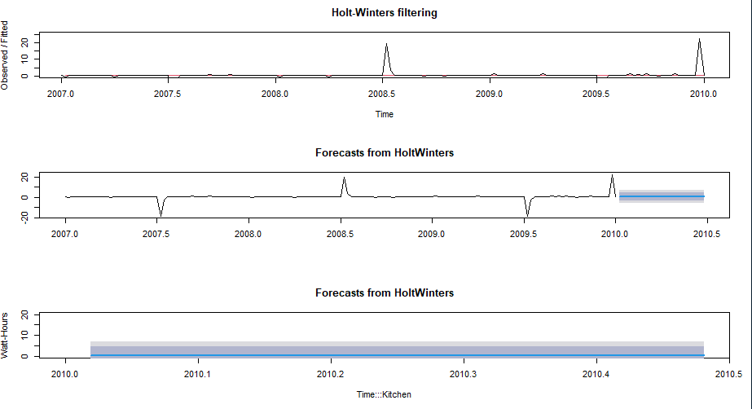
Kitchen: Holt-Winters Forecasting
This household currently does not cook very frequently.

Slide 23
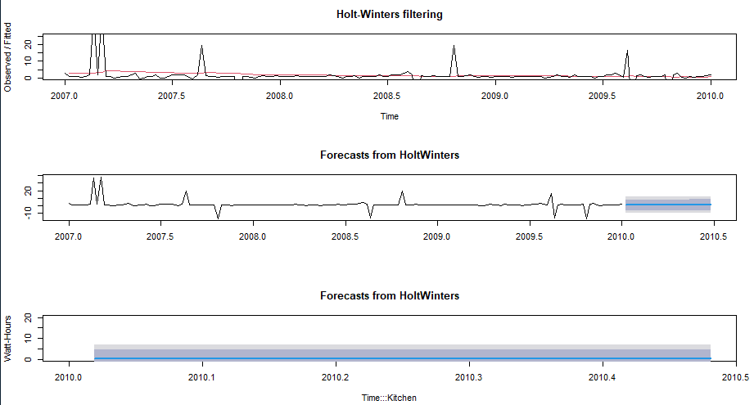
Laundry: Holt-Winters Forecasting
Appears to be between 0-5 watts/hour.

Slide 24
Conclusions
The energy used in the home during August 2008 supports the claim that the house was in fact empty.
The homeowner typically eats breakfast around 8 am and has dinner from 8:30-9:30.
In August, the homeowner typically eats outside of the home.
The homeowner appears to host Christmas every other year.

Slide 25
Summary Statement
In my opinion, the homeowner was not in residence during the period in question in August 2008. Compared to several other time periods, there was little or no energy usage during mid August 2008

Slide 26
Lessons Learned
This was an awesome project. I joined Datacamp and I did some of the Tidyverse and ggplot2 modules before tackling this unit. I found that I loved sorting and creating graphics for this project. The biggest lesson that I learned was to pace myself better. I spent so much time on the graphics that I may have ran short on understanding what the forecasting means and how it works. I usually dig in and do a lot of reading around what we are doing. I needed to wrap this up so I could catch up with the class.
There is a tip at the bottom of the last page that I think needs to be moved to the top. I saw this after I had used Tidyverse/ggplot2 for every graphic I could think of. I wanted to find out this households every habit.
This is the tip that came about a week too late.
Remember that it is your job as the data analyst not simply to do a bunch of analyses but more importantly to tell management what insight can be gained from the data they have provided to you.at I spent

